Slide 1

Computer Vision In the name of deep learning Group 32
Jinjiu Liu
Tony Dang
Nicola Croce
Sebastian Wehkamp
Final assignment computer vision

Slide 2
Classification task

Slide 3
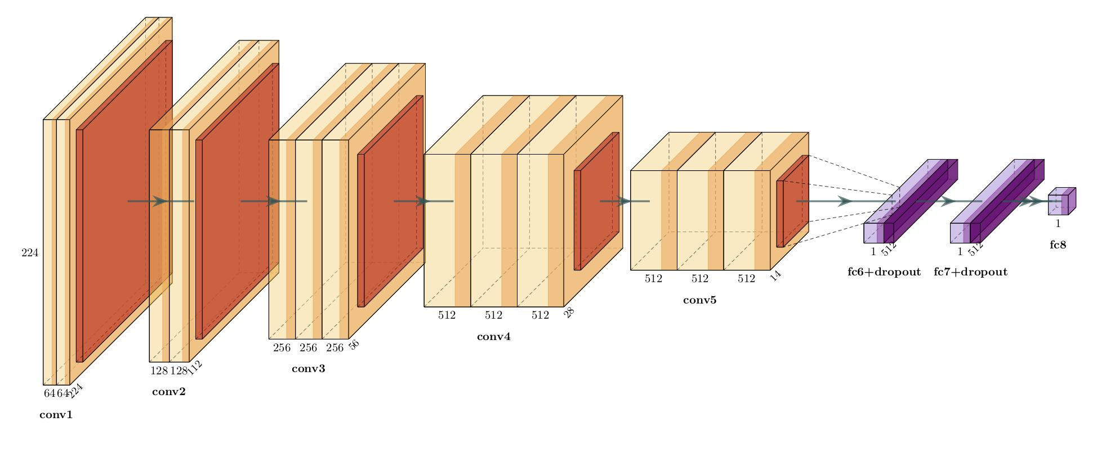
Model Structure - VGG16
Pretrained network: all VGG16 pretrained weights (ImageNet) frozen since these represent general features which can be reused, except conv5 (initialized with ImageNet, but not frozen such that further finetuning is possible)
Final layer to generate binary output is a sigmoid activation layer

Slide 4
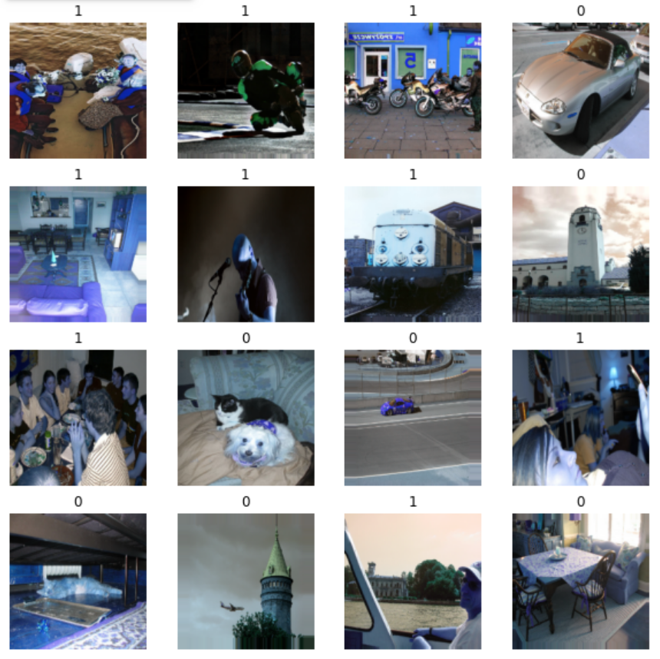
Data Pre-processing
Resize to (224, 224, 3)
Augmentation
Rescale to (0,1)
Shear (0, 0.2)
Zoom (0, 0.2)
Data generators with batch size 16

Slide 5
Training Phase
40 epochs with early stopping
Pre-trained model with frozen weights for vgg layers
Trained-from-scratch model with all trainable weights
Pre-trained model stopped after 7 epochs
Trained-from-scratch model stopped after 40 epochs

Slide 6
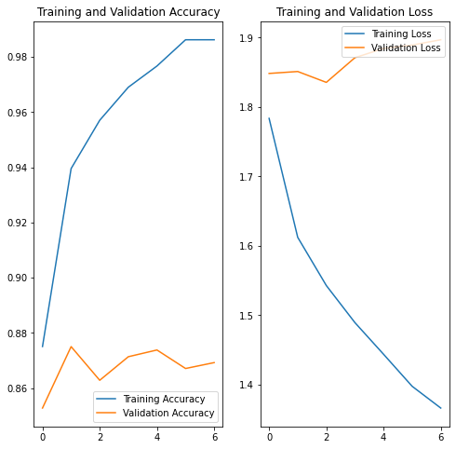
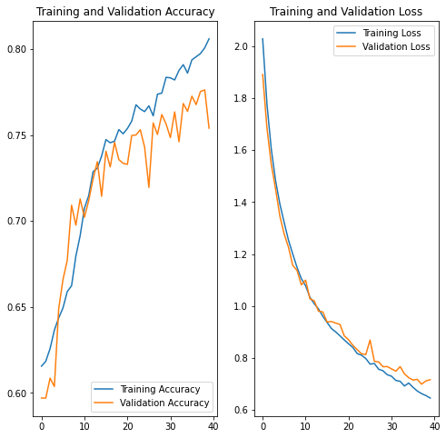
Performance and Analysis
Pre-trained
Trained-from-scratch

Slide 7
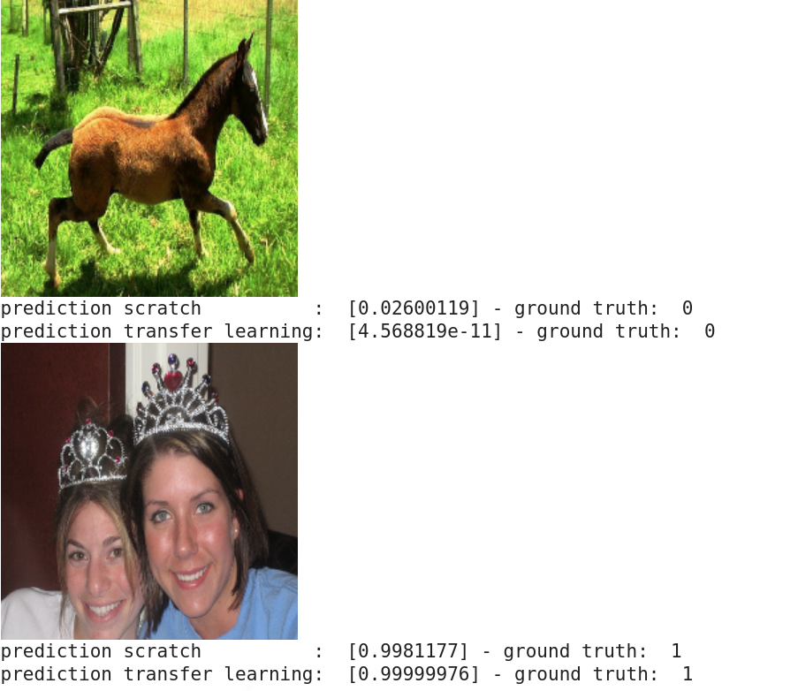
Performance and Analysis
Pre-trained model:
0.8700 accuracy on test set
True positive : 0.8019
True negative: 0.9201
Trained-from-scratch model:
0.7380 accuracy on test set
True positive : 0.5613
True negative: 0.8681
Both are biased
Better accuracy and generalization on pre-trained model

Slide 8
Binary segmentation task
Notes:
For the segmentation task we first attempted binary segmentation. Two models were trained, one from scratch and one using tranfser learning. First the structure of the models will be discussed followed by a performance comparison between the two models.

Slide 9
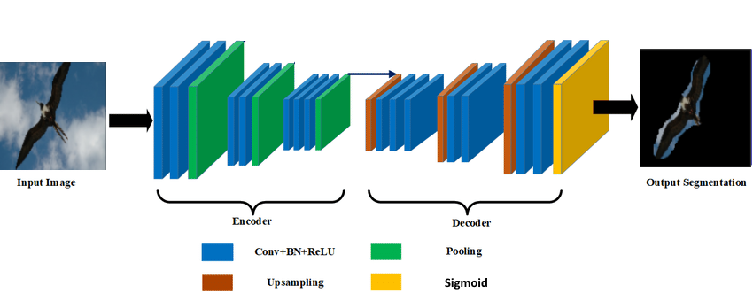
Model structure
Notes:
The from scratch trained model follows an Encoder-Decoder structure. The Encoder is based on three blocks each of which consists of a convolutional layer, a batch normalization layer, an activation layer, and a max pooling layer. This reduces the size to 16 filters of size 16 by 16. The decoder then attempts to upsample this to the original size by using similar blocks as the encoder except it uses an upsampling layer instead of a max pooling layer. The output is a segmented image.

Slide 10
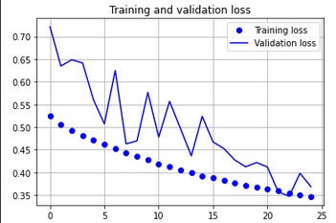
Loss function
Dice loss = 1 -
2|X∩Y|
|X|+|Y|
Notes:
Training is done by optimising the dice-loss function which is one of the most popular metrics in the field of image segmentation. It is defined as the size of overlap of the two segmentations divided by the total size of the two objects. The results of the loss function during training of both the training and validation set is shown in this image. It shows the stabilisation of the loss function over time on both the training and validation set while there is no sign of overfitting.

Slide 11
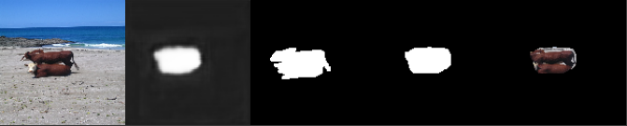
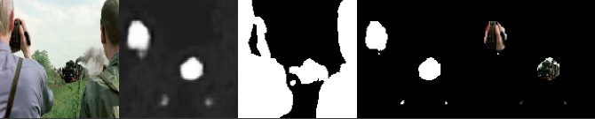
Network predictions
Good example
Bad example
Original image - Untresholded image - True segmentation - Predicted segmentation - Final output
Occlusions or cluttering in the images reduced the performance greatly
The available training data was also not meant for a background foreground segmentation, which might be an explanation for the reduced performance
Notes:
This slide shows some outputs of the network, the top image is a good prediction and the bottom one is a bad prediction. The first image is the input image which is followed by the untresholded output image. This untresholded image depicts the uncertainty involved in the prediction. The next image is the true segmentation followed by the thresholded image. The last image shows the final prediction. A clear difference between the good and bad example is the amount of uncertainty involved. In the case of the good prediction all uncertainty is located around the edges of the white part whereas in the bad prediction there are a lot of uncertain areas. Another interesting note is that in the case of the bad example the model specifically selected the train and the camera instead of arbitrary noise.

Slide 12
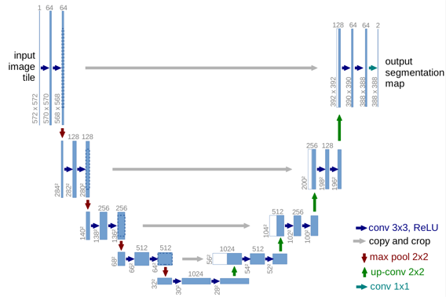
Transfer learning model (Unet)
Notes:
An interesting possibility for neural networks which we did not use in our network is skip connections. Skip connections are connections between layers further apart from each other, skipping other layers. One existing model which does have these skip connections is the Un-Net model which is popular int he field of Bio Medical image segmentation. This model will be used for transfer learning and is depicted on this slide.

Slide 13
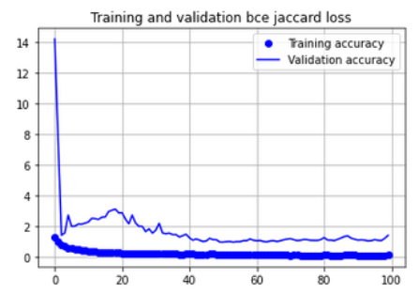
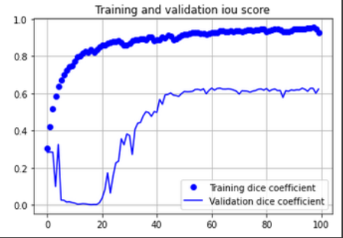
Loss function
Jaccard loss = 1-
|A∩B|
|A∪B|
Notes:
As a loss function we used the Jaccard loss which is very similar to the dice loss function discussed previously and they can be easily converted to each other. It is clearly visible that a lot of overfit is present during the training. After 40 epochs, the training showed no improvement anymore on the validation set. Hence, 100 epochs is a bit excessive in hindsight. What is interesting, is that the training seemed to get stuck in a local minimum between epoch 0-20 for the validation set. After 20 epochs, the loss on the validation set again decreased.

Slide 14
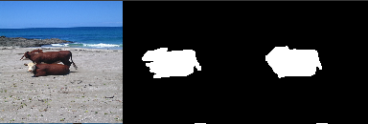

Network predictions
Good example
Bad example
Original image - True segmentation - predicted segmentation
Occlusions or cluttering in the images reduced the performance greatly
The available training data was also not meant for a background foreground segmentation, which might be an explanation for the reduced performance
Notes:
This slide shows the same examples as were shown for the from scratch trained model. The good example prediction is very similar to that of our model however the bad example is much better. Both persons are selected however the train itself is omitted which was selected by our model.

Slide 15
Semantic segmentation task
Notes:
We also performed multi class semantic segmentation.
For this task, we want to assign a class to each one of the pixels in the image. The total number of classes we care about is 21: 20 categories and 1 for the background.

Slide 16

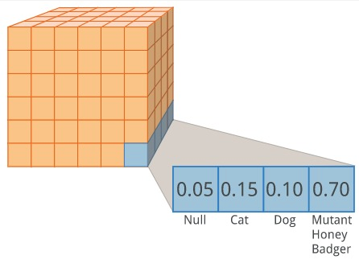
Background
.png mask
one-hot (single layer)
Predictions
0 | 0 | 0 | 0
0 | 1 | 1 | 0
0 | 1 | 0 | 0
0 | 0 | 0 | 0
One Hot Encoding
From segmentation .png pixel masks to a WxHxC tensor, where C = Number of classes (including background)
Notes:
First we made an important data processing step: transforming the labels, presented in a .png semantic mask, into one hot encoded representation. In this way, during predictions, we will have a tensor and a probability attached to each of the classes layer per each pixel, we will use an argmax to pick the most likely class and transform that back into a .png predicted mask.
.

Slide 17
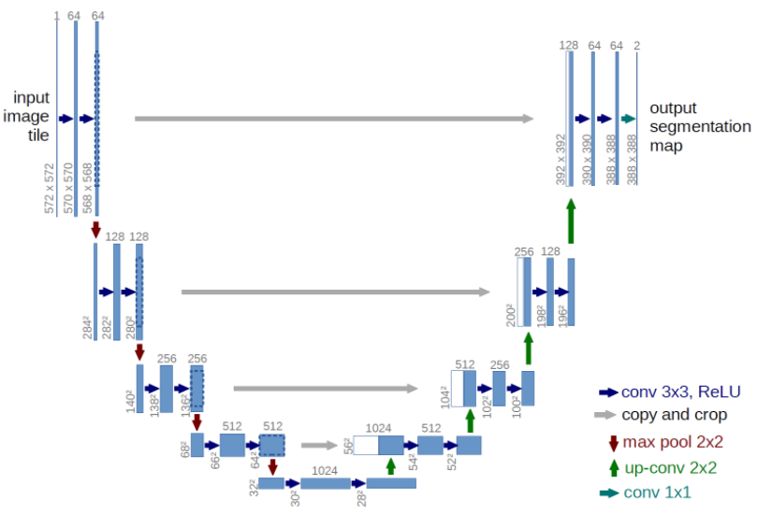
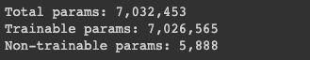
Model Architecture
U-NET Model
Loss Function: Categorical Crossentropy Loss
Trained from scratch: 200 epochs
Notes:
For this task, in order to have better comparability with binary segmentation, We used a U-Net model architecture as wll. Moreover the literature on semantic segmentation shows that this is a model that usually has good performances . We trained the model for 200 epochs.
.

Slide 18
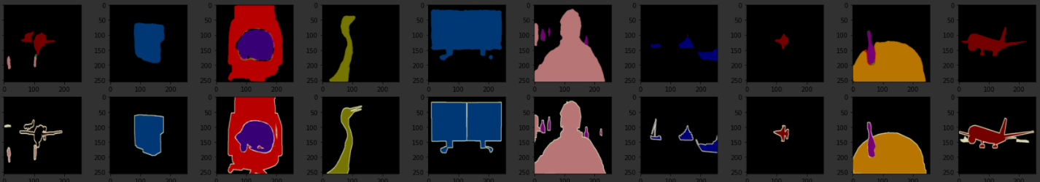
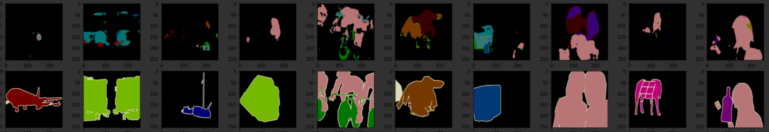
Masks Predictions
Training Set
Validation Set
Notes:
Visually, results on the training set are very encouraging. On the other hand, the predictions on the validation set are way off. This can show an overfitting problem on training set, despite the use of batch norm and dropout techniques to avoid it to happen.
From the result we can see that certain classes are predicted slightly better than others, for example "person" seem to have a little bit better predictions than "train" or "aeroplane". This can mean that some of the classes are underrepresented in the training set.
A few nobs that we could tweak to solve the issue if we had more time:
Perform data augmentation on the set, adding rotated and cropped images for example
Weigh the contribution of the classes according to their predominancy in the dataset to make sure that the underrepresented classes are as relevant as the over represented ones
Another approach could also be to start with a simpler model. As mentioned before, complex models are sensitive to overfitting when only a small dataset is available

Slide 19
Adversarial examples

Slide 20
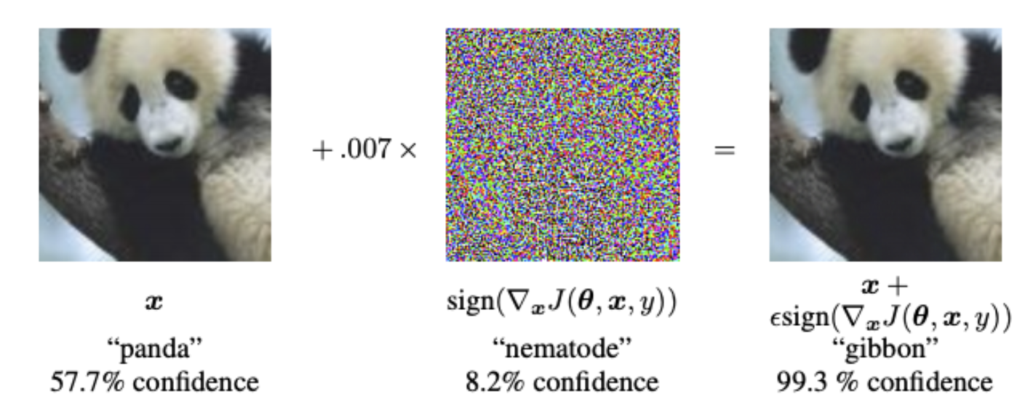
Goal of the adversarial task
Generate adversarial examples to fool the trained classifier from task 1
The perturbations on the original images must remain small
The perturbations are generated using an encoder-decoder structure
A white-box attack is assumed
Compare performance of model trained on training data and test data of the classifier
Goodfellow, Ian J., Jonathon Shlens, and Christian Szegedy. "Explaining and harnessing adversarial examples." arXiv preprint arXiv:1412.6572 (2014).

Slide 21
Overview
Load classifier and freeze its weights.
Build the encoder-decoder to generate perturbations.
Combine encoder-decoder with pretrained classifier.
Generate deceptive labels.
Training phase (on training data and test data of the classifier).
Analyze the performance of both models.
Conclusion.

Slide 22
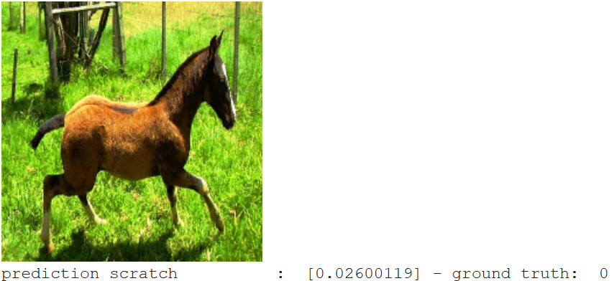
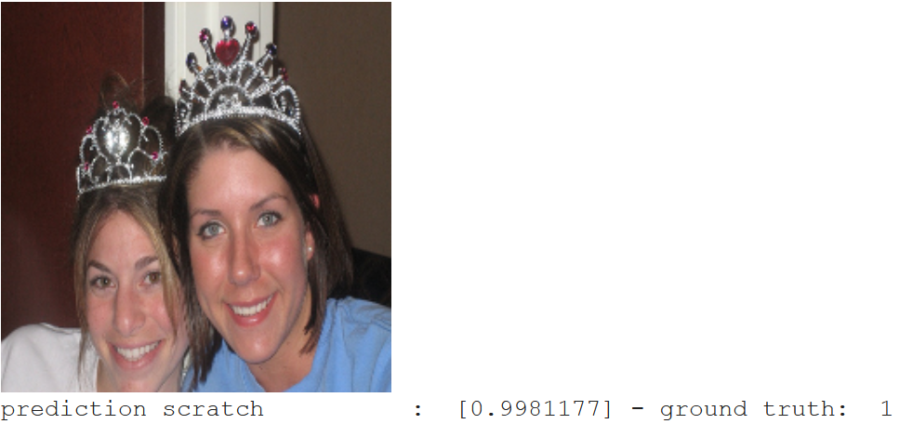
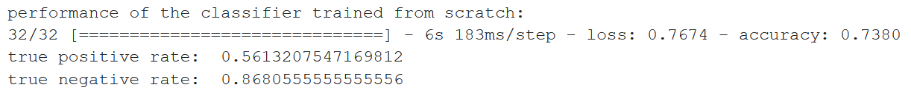
1. Loading the pretrained classifier
Classifier trained from scratch
Freeze the weights!
Overall accuracy on test data of 73.80%

Slide 23
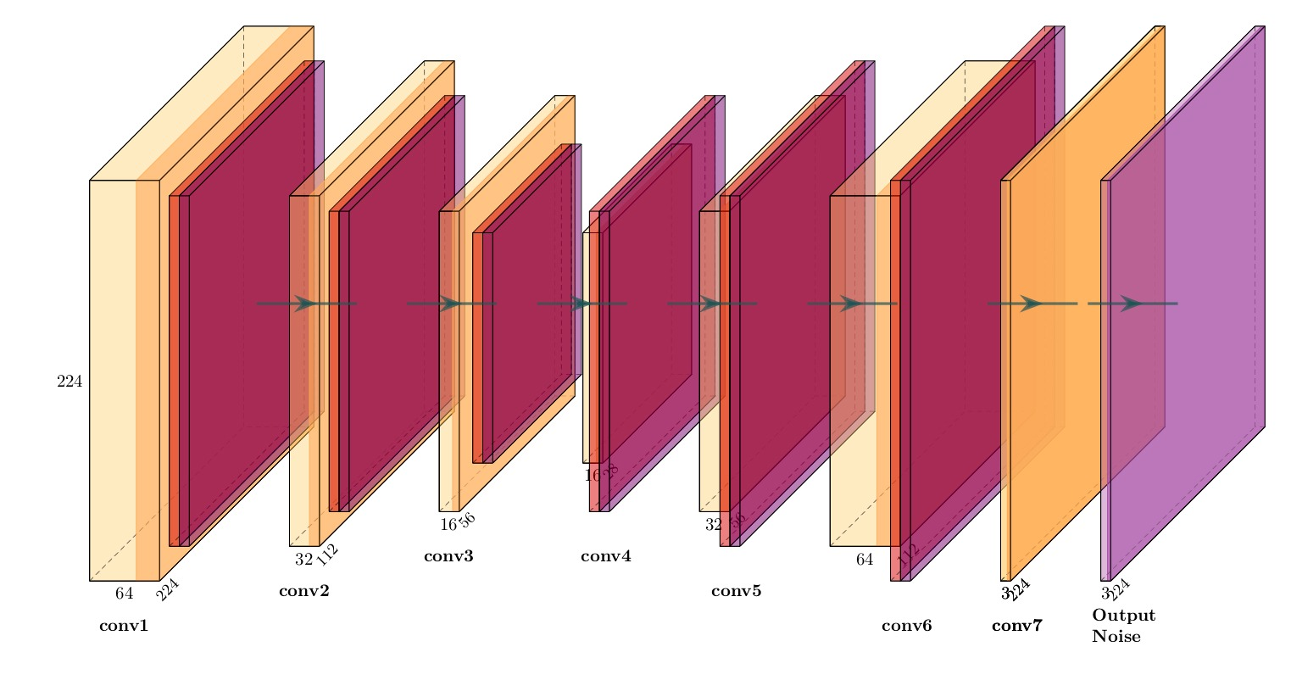
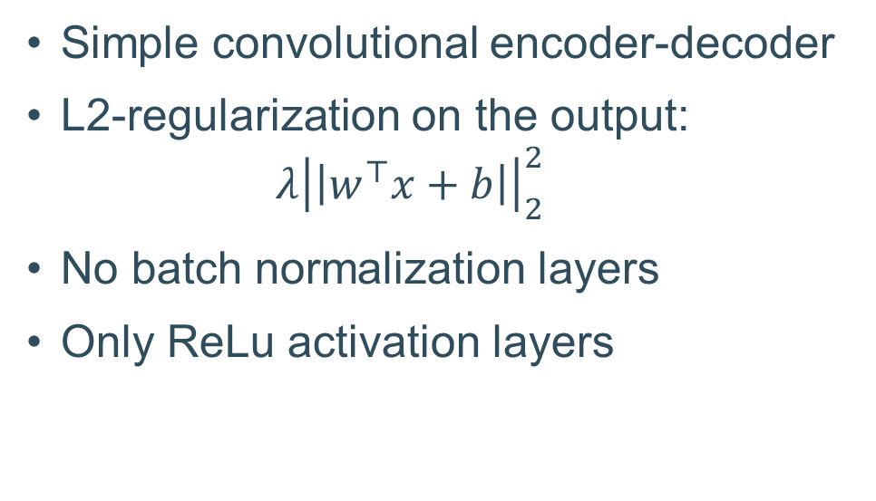
2. Build the encoder-decoder for the perturbations

Slide 24
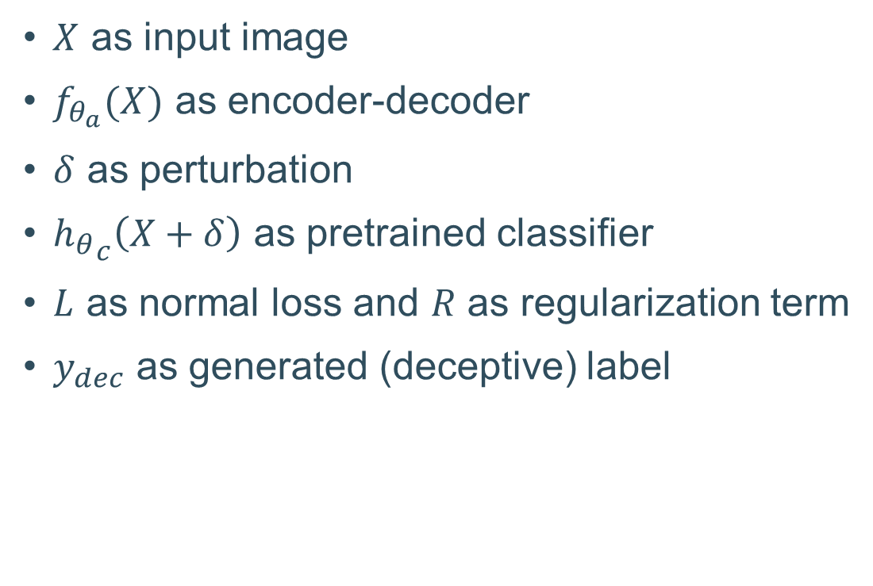
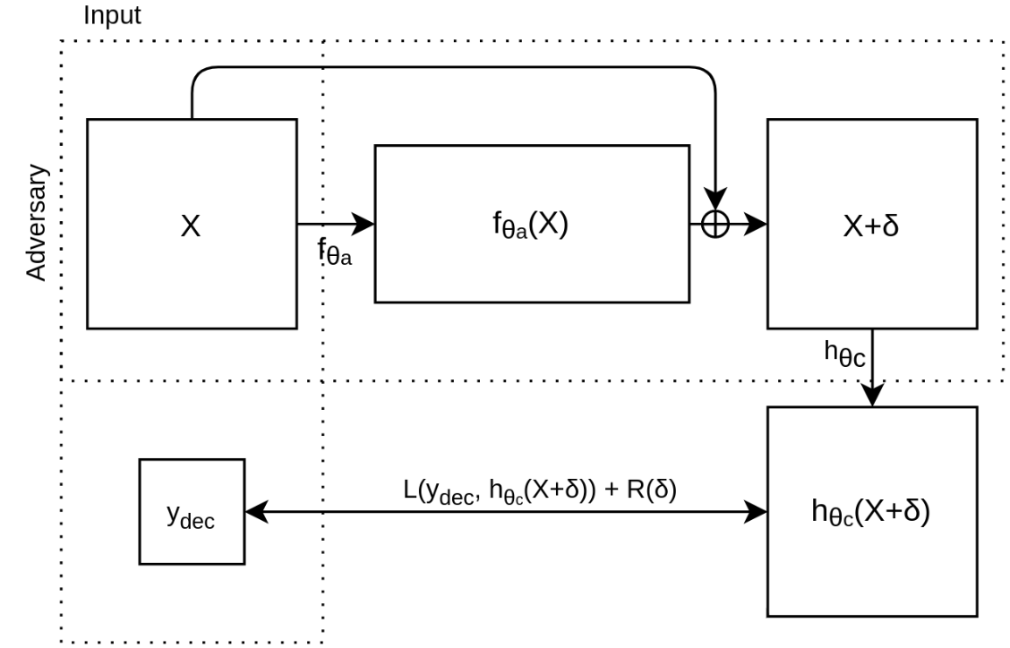
3. Combine encoder-decoder with classifier

Slide 25
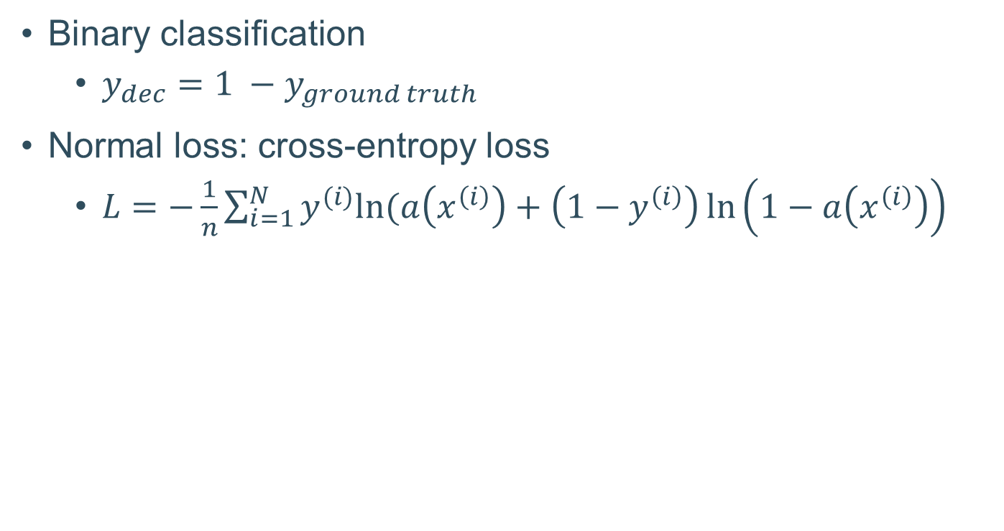
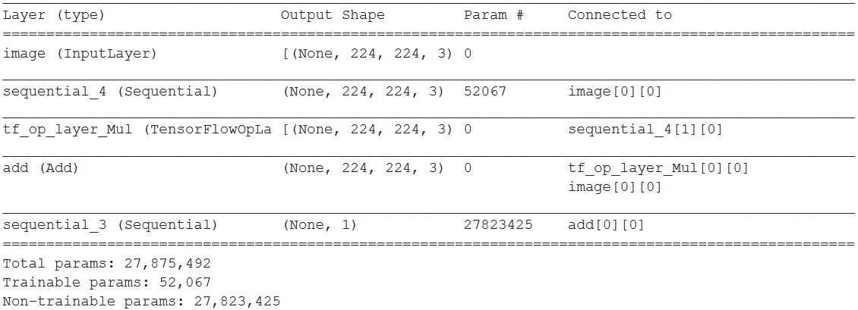
4. Generate the deceptive labels

Slide 26
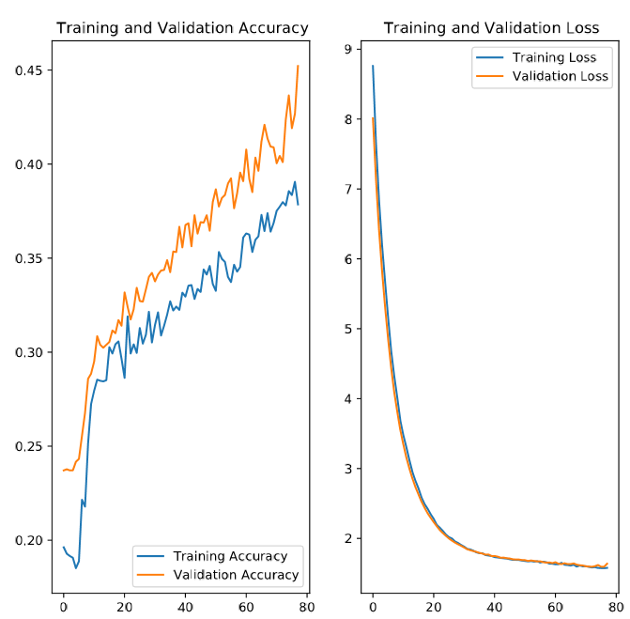
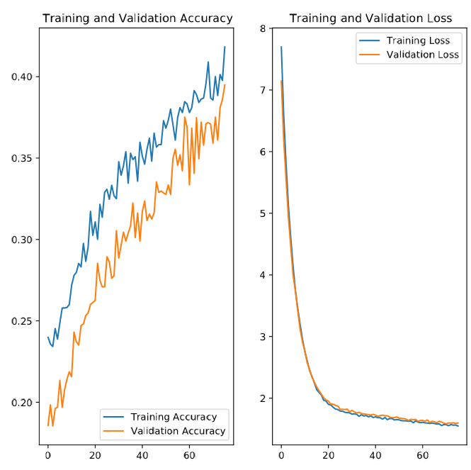
5. Training phase
100 epochs with early stopping
White-box attack
Training on training data of the classifier (model 1)
Stops around 80 epochs
Validation accuracy is higher (test data of the classifier)
Training on test data on the classifier (model 2)
Stops around 80 epochs
Training accuracy is higher (test data of the classifier)

Slide 27
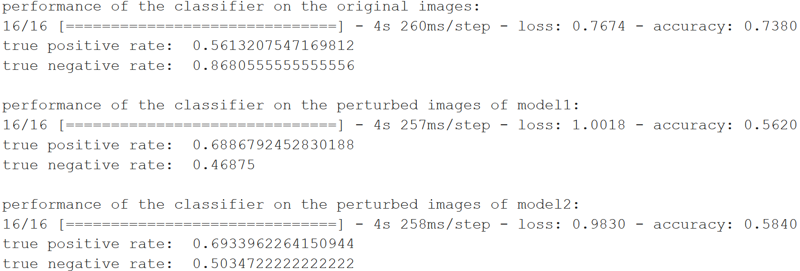
6. Analyze the performance of both models (i)
Accuracy drop of 17% (model 1) and 15% (model 2)
Better fooling of the pretrained classifier for model 1 on separate test set
Why? Is there a difference when training on training or test set of the classifier?
Remarkable: true positive and negative rate switched around

Slide 28
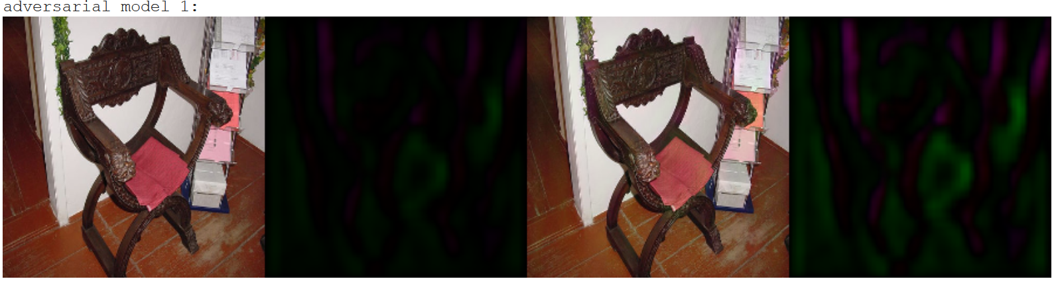
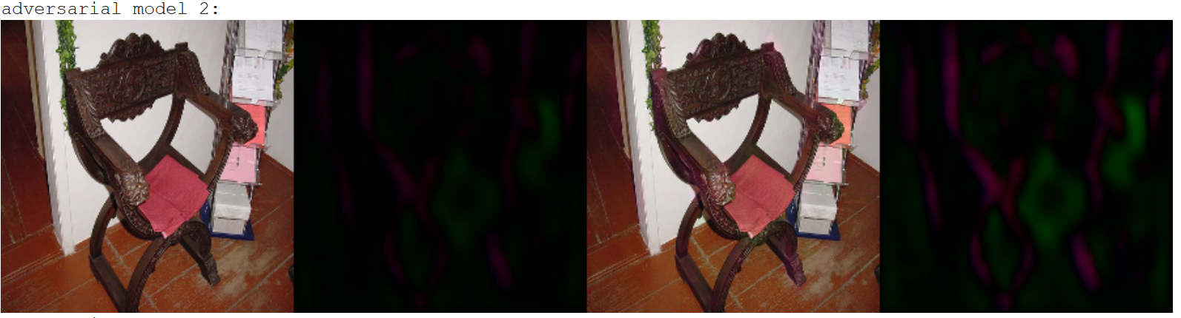
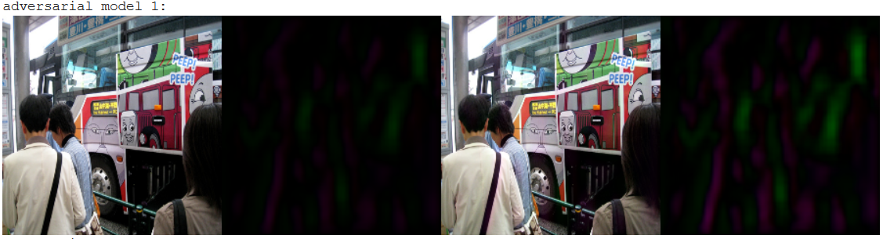
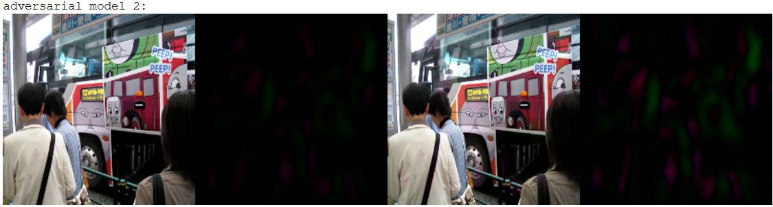
6. Analyze the performance of both models (ii)
Model 1
Model 2
1. original image - 2. perturbation - 3. perturbed image - 4. magnified perturbation (x2)

Slide 29
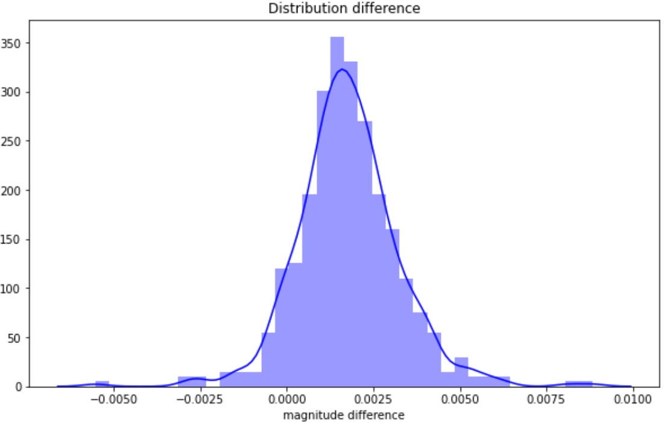
6. Analyze the performance of both models (iii)
Model 1 generates larger perturbations than model 2
Model 1 trained on training set of classifier
Trade-off between normal loss and regularization
Explanation why model 1 performs better on separate test set

Slide 30
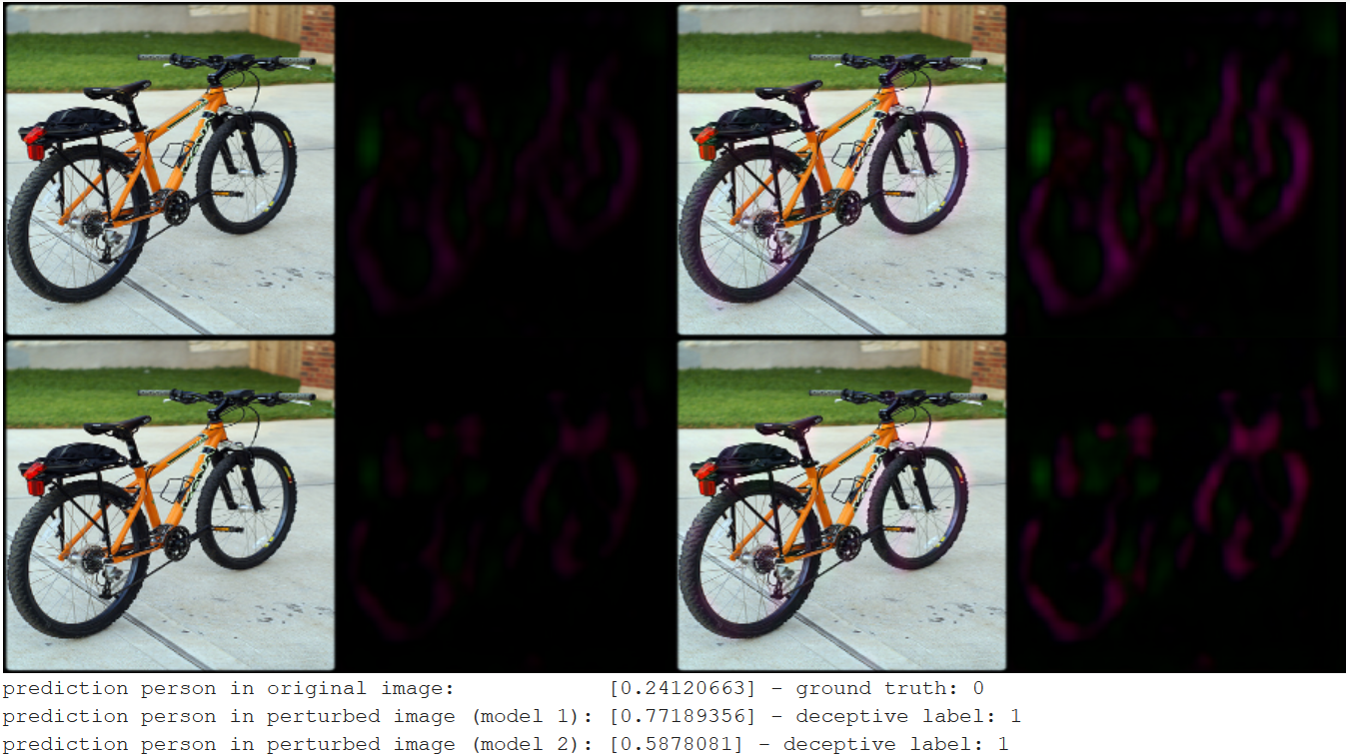
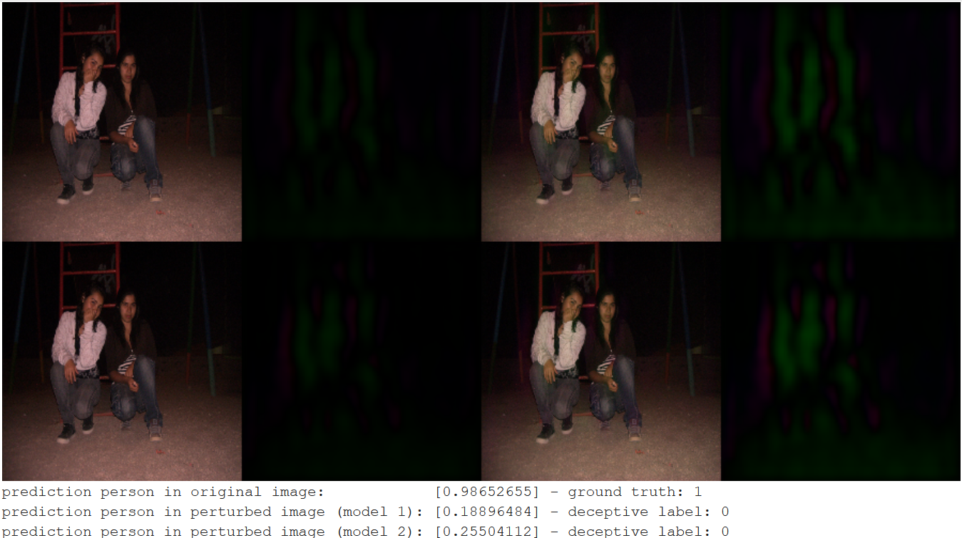
6. Analyze the performance of both models (iv)
1. original image - 2. perturbation - 3. perturbed image - 4. magnified perturbation (x2)

Slide 31
7. Conclusion
Successful fooling of the classifier using a white-box attack
Drop in performance of 17% and 15%
Achieved by implementing a light-weight convolutional encoder-decoder
Difference when training on training or test set of the classifier
Showed some weaknesses of the pretrained classifier
Perturbed images can be used as additional training data
If more time available
Exploring of different types of encoder-decoders
Exploring effect of defining a more complex encoder-decoder, e.g. skip connections

Slide 32
1. Classification task 2. Binary segmentation (Semantic segmentation) 4. Adversarial examples

